Slide 1

MiniProject(19AI701) – Review2
ONLINE VOTING SYSTEM
Submitted by:
KAMALESHWAR KV(212223240063)
2023-2027 Batch
TEAM NO: 023
Under the guidance of:
Dr.VIJAYAN P
AP(SG),Department of AIML
DEPARTMENT OF ARTIFICIAL INTELLIGENCE AND DATASCIENCE
SAVEETHA ENGINEERING COLLEGE
(Autonomous Institution – UGC, Govt. of India)
(Affiliated to Anna University, Approved by AICTE - Accredited by NBA & NAAC – ‘A’ Grade - ISO 9001:2015 Certified)
Saveetha Nagar, Thandalam, Chennai-602 105, TamilNadu, INDIA.

Slide 2
Agenda
Introduction
Statement of the Problem
Scope of the project
Methodology
Architectural Diagram
Flow
Algorithm used
Design - Use Case Diagram, Class Diagram
Implementation
Important code segments
Output, Results
Test Cases
Conclusions
Future work
References

Slide 3
Introduction
To provide a secure and reliable platform for citizens to cast their votes online.
To enable authorized voters to participate without visiting physical polling
stations.
To overcome the drawbacks of traditional voting methods like ballot papers
and EVMs.
To ensure key features such as accuracy, privacy, convenience, flexibility, verifiability, and mobility.
To minimize issues like paperwork, machine damage, lack of higher official involvement, and mass update limitations.
To allow voters to cast votes from anywhere in the country in a safe and secure manner.
To increase voter turnout by making the process simple, accessible, and
user-friendly.
To promote fearless voting by reducing risks of violence and external pressures.
To contribute to the vision of Digital India by integrating technology with the democratic process.

Slide 4
Statement of the Problem
Voters must visit physical polling stations, which is time-consuming and inconvenient.
Manual verification of voter identity can lead to human errors, impersonation, and fraudulent voting practices.
Counting votes manually is tedious and may result in inaccuracies or delays in announcing results.
Maintaining and securing physical records of votes requires significant resources and poses challenges in data management.
People living away from their registered constituencies (e.g., students, employees, or citizens abroad) face difficulties in participating in the voting process.
There is a lack of transparency and real-time accessibility in the traditional voting process.
The current system does not effectively utilize technology to ensure fast, secure,
and reliable voting.
Therefore, there is a need for a web-based Online Voting System that enables secure user authentication,allows eligible voters to vote electronically, and ensures accuracy, transparency, and efficiency in vote counting.

Slide 5
Scope of the project
Facilitates adding, updating, and displaying candidate information.
Enables voters to cast their votes securely through an online interface.
Ensures only authorized and registered users can access and vote using secure login credentials.
Allows new voters to register online and stores their details in a secure database.
Provides administrators with access to manage elections, candidates, and voter data.
Facilitates adding, updating, and displaying candidate information.

Slide 6
Scope of the project
Restricts voting to specific dates and times set by the administrator.
Maintains logs of all voting activities for transparency and verification.
Provides a user-friendly interface accessible from various devices (PC, mobile, tablet).
Designed to handle large numbers of voters and multiple elections simultaneously.
Ensures error-free voting through validation checks and feedback messages.
Generates detailed reports of election results for administrative and record purposes.

Slide 7
Methodology
1. Requirement Analysis: Identify user needs, system requirements, and constraints.Define roles such as Admin, Voter, and Candidate.Determine security measures like authentication and data encryption.
2. System Design: Design the architecture of the system (frontend, backend, and database).Create ER diagrams, DFDs, and use case diagrams for system flow.Plan user interfaces for easy navigation and accessibility.
3. Database Design: Develop a secure database to store voter details, candidate information, and voting records.Ensure data normalization and implement constraints for data integrity.
4. Implementation: Develop the frontend using technologies like HTML, CSS, JavaScript, Tkinter (if desktop), or frameworks as required.Build the backend using Python, PHP, or Java connected to databases like MySQL or SQLite.Implement security features like password hashing and session control.

Slide 8
Methodology
5. Testing: Conduct unit testing, integration testing, and system testing.Test for security vulnerabilities such as multiple voting, SQL injection, and data breaches.Verify system performance under different load conditions.
6. Deployment: Host the system on a secure server or deploy locally for institutional elections.Configure admin control panels and access permissions.
7. Evaluation and Feedback: Collect user feedback to identify usability or security issues.Refine the system based on suggestions and performance results.
8. Maintenance and Updates: Regularly update the system to improve features and fix bugs.Ensure data backup and maintain audit trails for transparency.

Slide 9
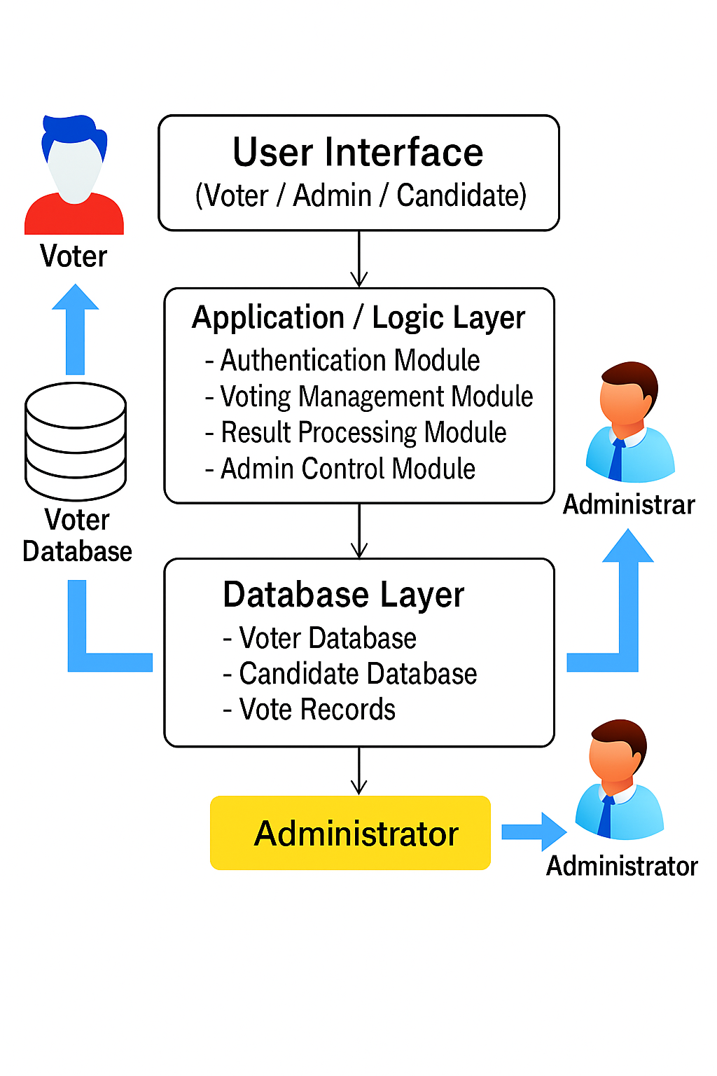
Architecture Diagram/Flow

Slide 10
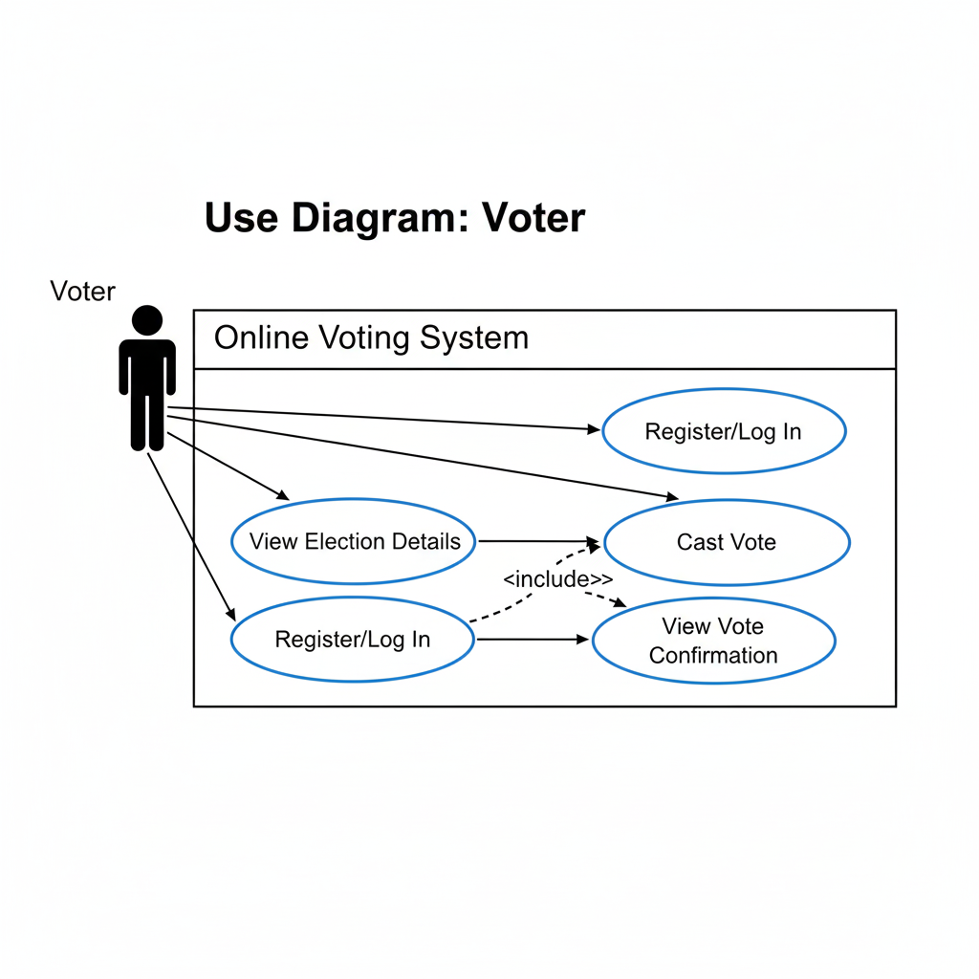
Design-Use Case Diagram
UML DIAGRAMS
Use case Diagram:A use case diagram is a graph of actors set of use cases enclosed by a system boundary, communication associations between the actors and users and generalization among use cases.
The use case model defines the outside (actors) and inside (use case) of the system’s behavior.
VOTER :

Slide 11
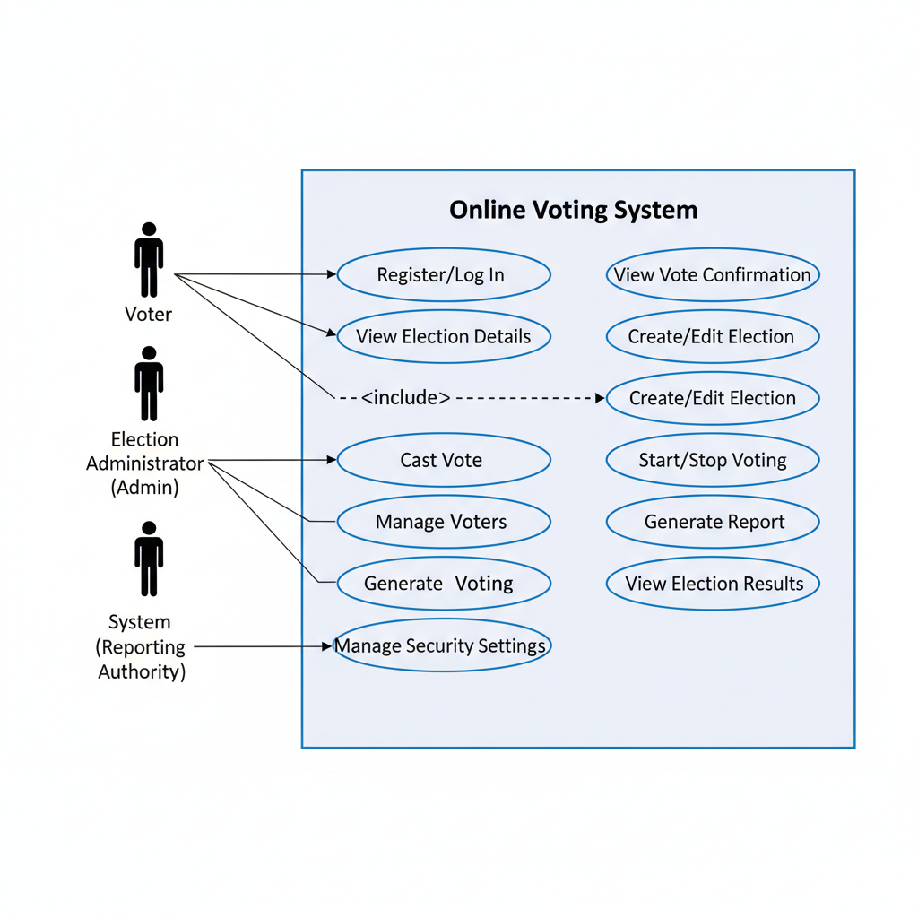
Design-Use Case Diagram
UML DIAGRAMS
ADMIN

Slide 12
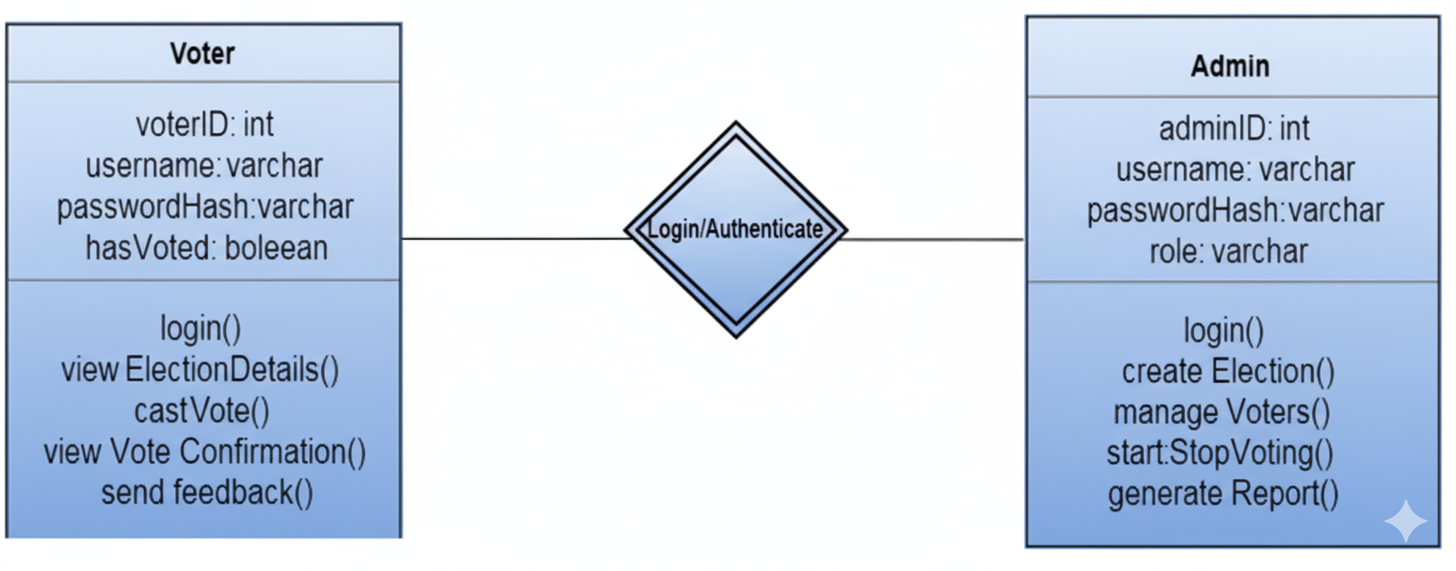
Design-Class Diagram
Class Diagram:A class is a representation of an object and, in many ways; it is simply a template from which objects are created. Classes form the main building blocks of an object-oriented application.
Although thousands of students attend the university, you would only model one class, called Student, which would represent the represent the entire collection of students.

Slide 13
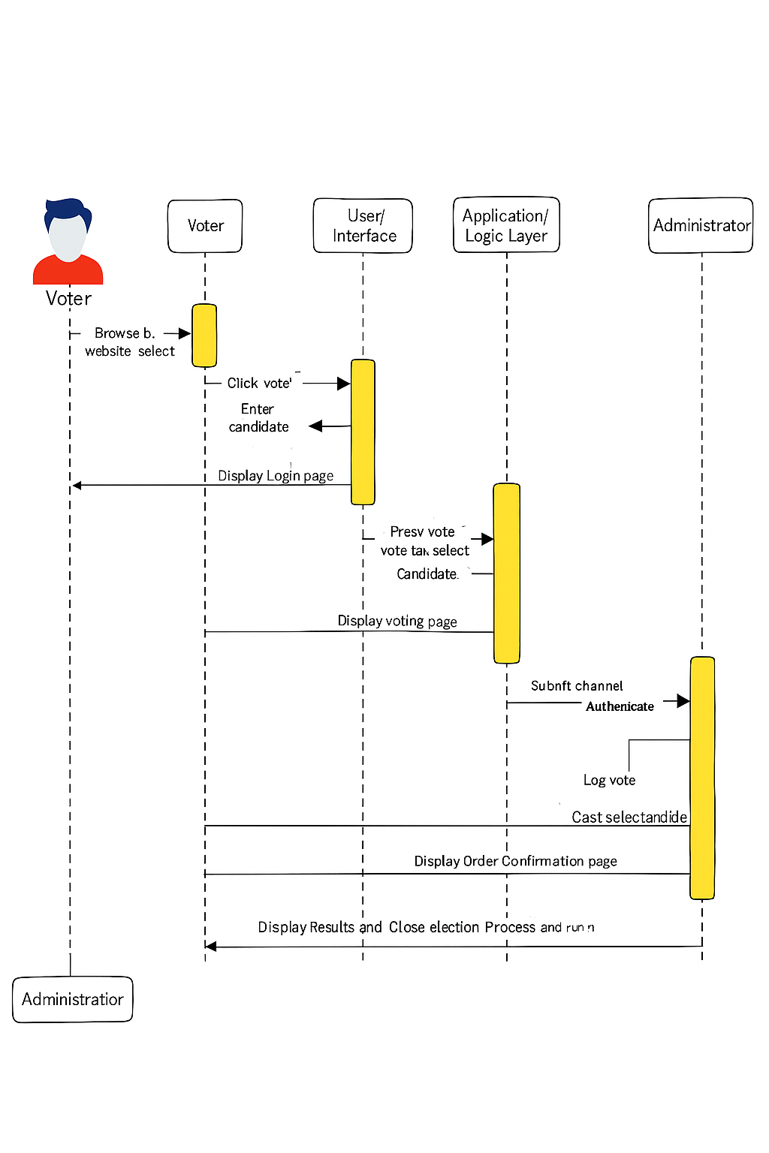
Sequence Diagram - ecommerce example

Slide 14
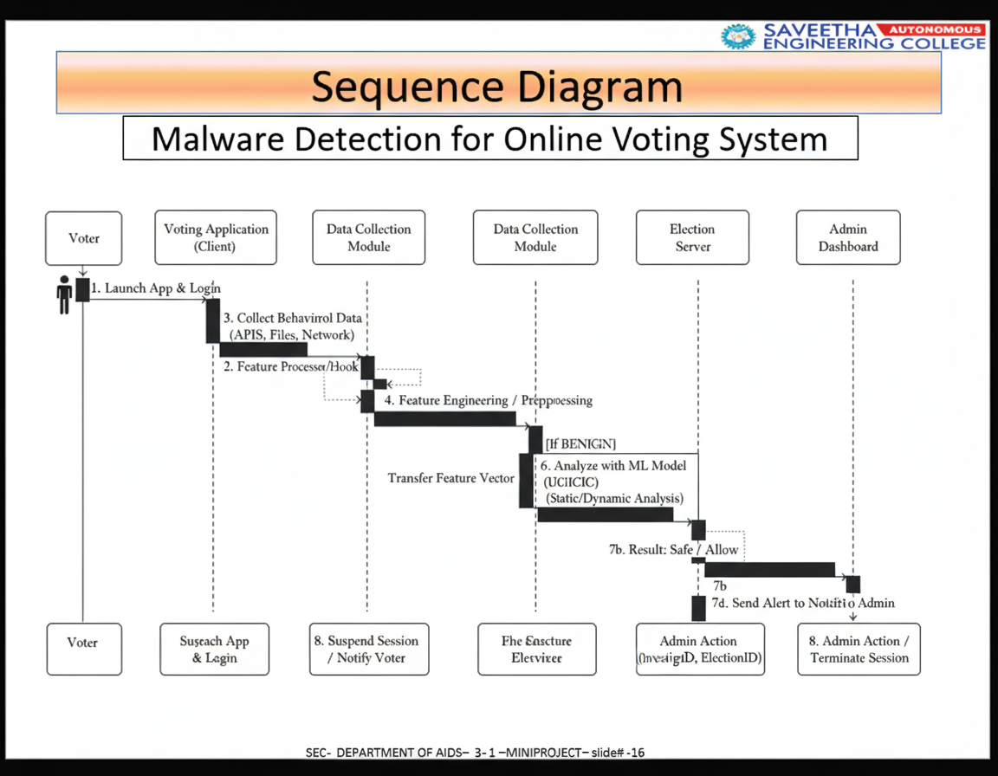
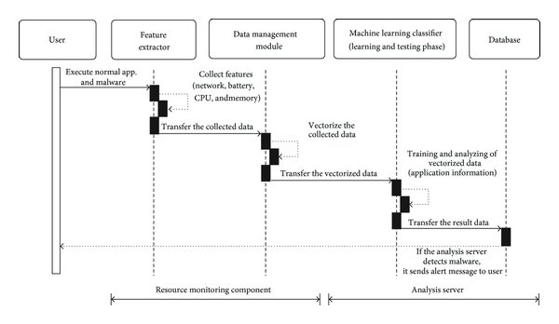
Sequence Diagram
malware detection using machine learnng example

Slide 15
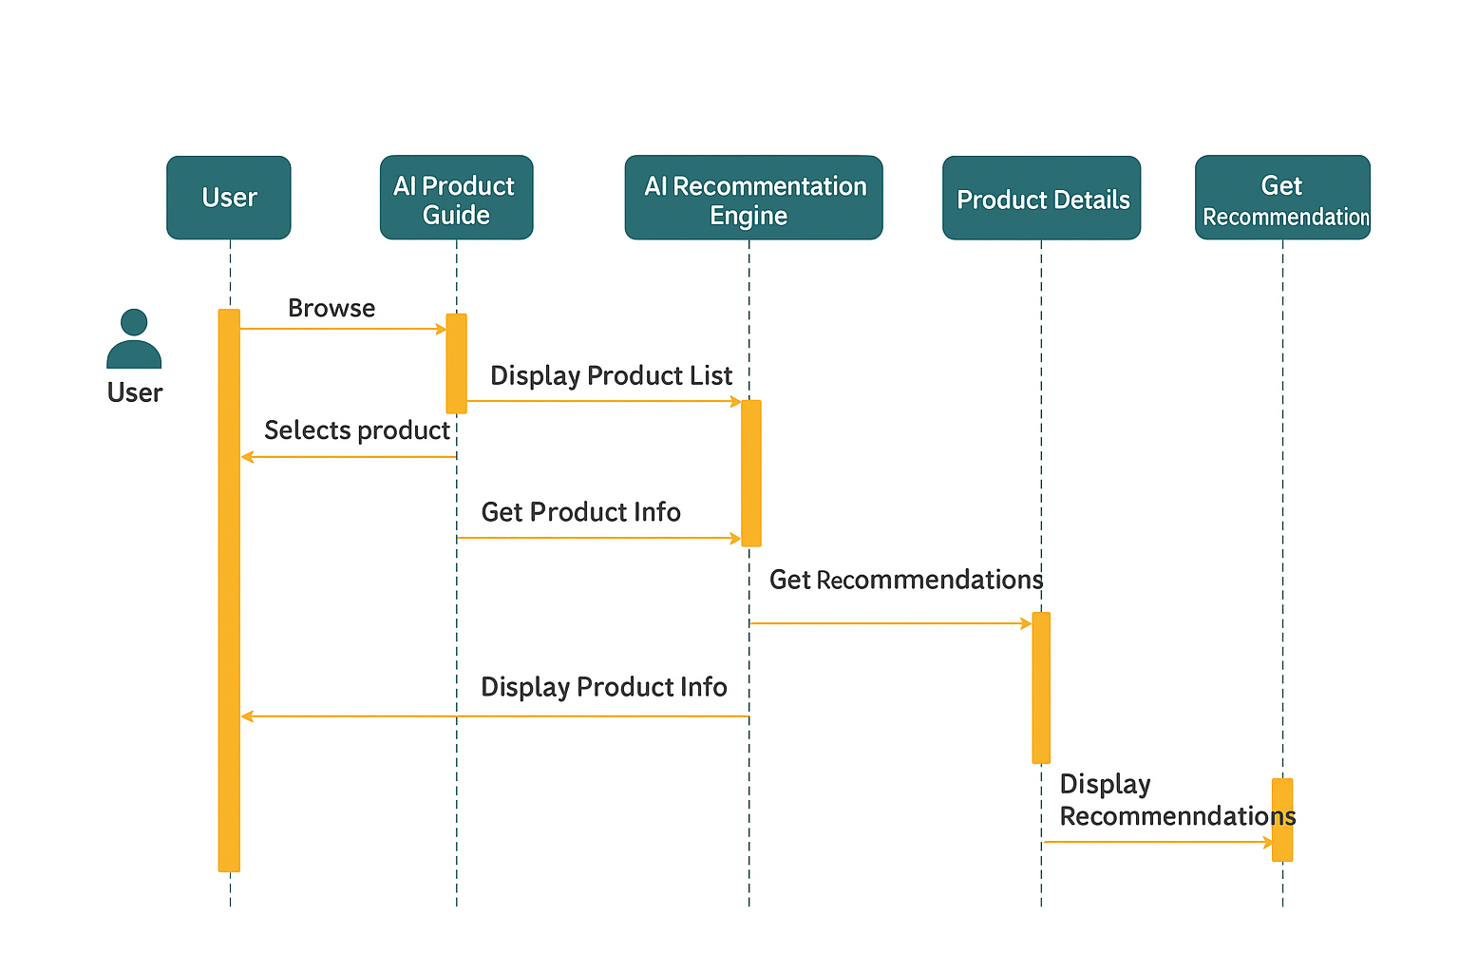
Sequence Diagram
AI Product guide example

Slide 16
Algorithms used
The project uses following Algorithms:
1. AES (Advanced Encryption Standard):
AES is a symmetric encryption algorithm used to secure sensitive voting data such as voter credentials and vote records.
It ensures that the votes and voter details are stored in an encrypted format, preventing unauthorized access or data manipulation.
The encryption and decryption processes are fast, making AES suitable for real-time secure communication during the voting process.
It provides confidentiality, integrity, and data security throughout the online voting process.
2. SHA-256 (Secure Hash Algorithm):
SHA-256 is used for hashing sensitive information such as passwords, voter IDs, and vote transaction records.
Each hash is unique, ensuring that data cannot be reversed or altered, providing strong protection against tampering.
It guarantees that the vote data and authentication information remain immutable and verifiable.
SHA-256 helps maintain data integrity across all components of the voting system.

Slide 17
Algorithms used
The project uses following Algorithms:
OTP (One-Time Password) Authentication Algorithm:
The OTP algorithm provides a temporary password to verify voter identity during login or registration.
It enhances security by ensuring that only legitimate users can access their voting accounts.
Each OTP is valid for a short duration and cannot be reused, minimizing the risk of unauthorized access.
This algorithm ensures multi-factor authentication, adding an additional layer of protection against impersonation.
Blockchain Hashing Algorithm (Optional for Audit Trail):
Used to create a tamper-proof ledger of all voting transactions.
Each vote record is stored as a block with a cryptographic hash linking it to the previous block, forming an immutable chain.
It guarantees transparency, traceability, and verifiability of all votes while preserving voter anonymity.
Ensures that once a vote is cast, it cannot be altered or deleted.

Slide 18
Hardware and software selection
a. Server-Side Hardware:
Processor: Intel Core i5 / AMD Ryzen 5 or higher
RAM: Minimum 8 GB (recommended 16 GB for multiple users)
Storage: 500 GB SSD or more for faster data access
Network: High-speed Internet connection with stable bandwidth
Power Backup: UPS or generator to ensure uninterrupted service
Security Devices: Firewall hardware or dedicated security gateway
b. Client-Side Hardware (Voters / Admin):
Processor: Intel Core i3 or equivalent
RAM: Minimum 4 GB
Storage: 50 GB free space
Input Devices: Keyboard and Mouse
Display: 15-inch or higher monitor (or smartphone screen if mobile interface)
Network: Reliable Internet connection or LAN access

Slide 19
Hardware and software selection
2. Software Requirements
a. Operating System:
Server: Linux (Ubuntu / CentOS) or Windows Server
Client: Windows 10/11, macOS, or any OS with a modern web browser
b. Programming Languages:
Frontend: HTML, CSS, JavaScript (for web) or Python Tkinter (for desktop interface)
Backend: Python / PHP / Java
Database: MySQL / SQLite / PostgreSQL
c. Development Tools and Frameworks:
IDE: Visual Studio Code / PyCharm / Eclipse
Frameworks: Flask / Django (for Python-based systems) or Laravel (for PHP)
Libraries: Tkinter, Pandas, and SQLite3 for Python GUI and database management
API Support: RESTful APIs for data communication between frontend and backend
d. Security Software:
SSL/TLS Certificates for data encryption
Firewall and antivirus protection
Secure hashing and encryption libraries (e.g., bcrypt, hashlib, pycryptodome)
e. Testing Tools:
Selenium or PyTest for functional testing
Postman for API testing
SQLMap for database vulnerability assessment

Slide 20
Implementation
1. Frontend
The user interface (UI) is designed using HTML, CSS, and JavaScript.
Voters can register, log in, and cast their vote through simple web pages.
Admins can add candidates, start or stop elections, and view results.
2. Backend
The backend is developed using Python and Flask.
Flask handles all server-side operations such as login verification, voting, and result calculation.
Each request from the frontend (like “cast vote”) is processed securely by Flask routes.
3. Database
The system uses SQLite to store all information.
It contains tables for:
Voters – stores user details and login credentials.
Candidates – stores details of candidates in the election.
Elections – contains election schedules and status.
Votes – records each vote cast by a user.

Slide 21
Important Code segments
INPUT DATASET
import sqlite3
# Create database and tables
conn = sqlite3.connect('voting.db')
cursor = conn.cursor()
cursor.execute('''CREATE TABLE IF NOT EXISTS voters (
voter_id INTEGER PRIMARY KEY AUTOINCREMENT,
username TEXT UNIQUE,
password TEXT,
voted INTEGER DEFAULT 0
)''')
cursor.execute('''CREATE TABLE IF NOT EXISTS candidates (
candidate_id INTEGER PRIMARY KEY AUTOINCREMENT,
name TEXT,
votes INTEGER DEFAULT 0
)''')
conn.commit()
conn.close()

Slide 22
Important Code segments
from flask import Flask, render_template, request, redirect
import hashlib
app = Flask(__name__)
def hash_password(password):
return hashlib.sha256(password.encode()).hexdigest()
@app.route('/register', methods=['POST'])
def register():
username = request.form['username']
password = hash_password(request.form['password'])
conn = sqlite3.connect('voting.db')
cursor = conn.cursor()
try:
cursor.execute("INSERT INTO voters (username, password) VALUES (?, ?)", (username, password))
conn.commit()
msg = "Registration Successful!"
except:
msg = "Username already exists!"
conn.close()
return msg

Slide 23
Important Code segments
@ app.route('/login', methods=['POST'])
def login():
username = request.form['username']
password = hash_password(request.form['password'])
conn = sqlite3.connect('voting.db')
cursor = conn.cursor()
cursor.execute("SELECT * FROM voters WHERE username=? AND password=?", (username, password))
user = cursor.fetchone()
conn.close()
if user:
return redirect('/vote')
else:
return "Invalid Login Credentials!“
@app.route('/vote', methods=['POST'])
def vote():
username = request.form['username']
candidate_id = request.form['candidate_id']
conn = sqlite3.connect('voting.db')
cursor = conn.cursor()
# Check if voter has already voted
cursor.execute("SELECT voted FROM voters WHERE username=?", (username,))
voted = cursor.fetchone()[0]
if voted == 0:
cursor.execute("UPDATE candidates SET votes = votes + 1 WHERE candidate_id=?", (candidate_id,))
cursor.execute("UPDATE voters SET voted = 1 WHERE username=?", (username,))
conn.commit()
msg = "Vote Cast Successfully!"
else:
msg = "You have already voted!"
conn.close()
return msg

Slide 24
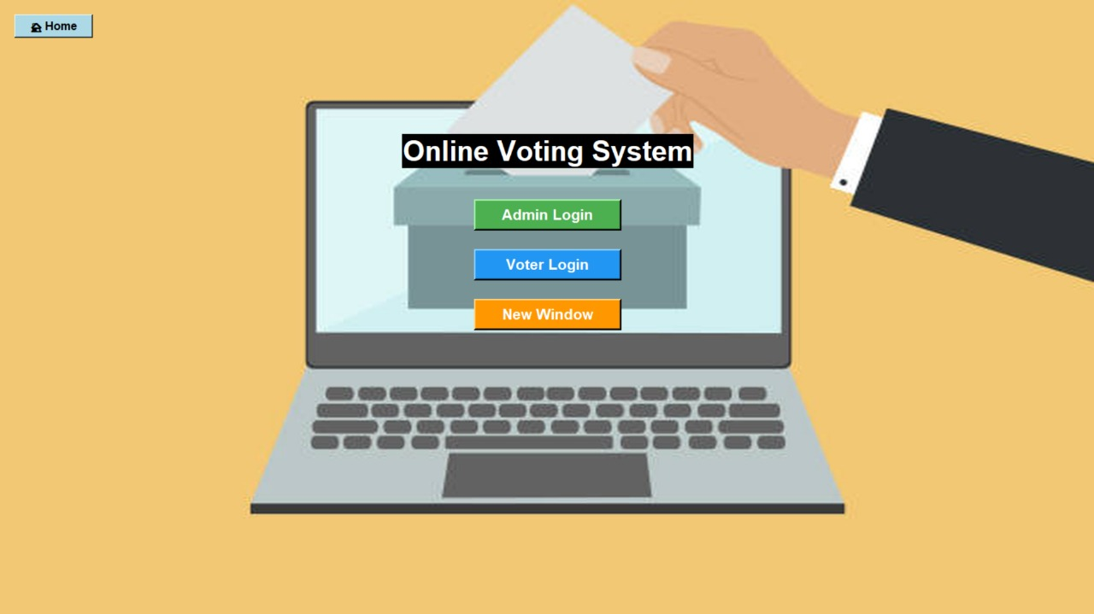
Output
OUTPUT:
The homePage.py output displays the main menu of the system and acts as the gateway to all other modules.

Slide 25
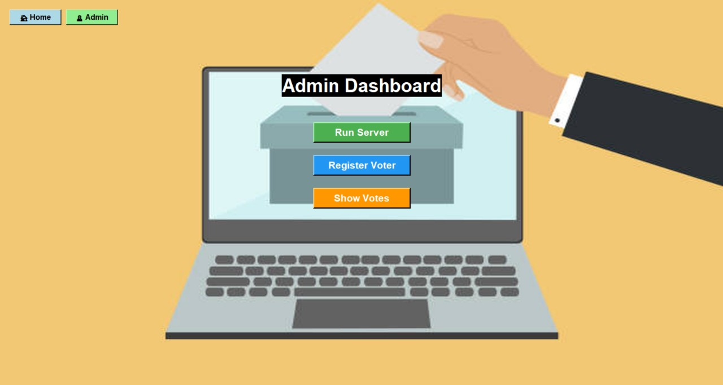
Output
OUTPUT:
The Admin Dashboard provides the admin with full control over the election process through a simple and interactive interface.

Slide 26
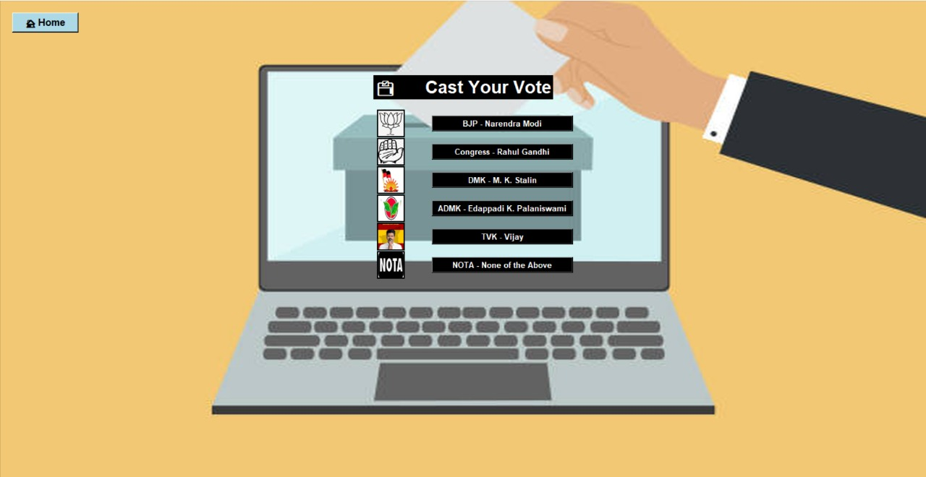
Output
OUTPUT:
The Voting Page allows the voter to securely cast their vote for their chosen candidate and confirms successful submission.

Slide 27
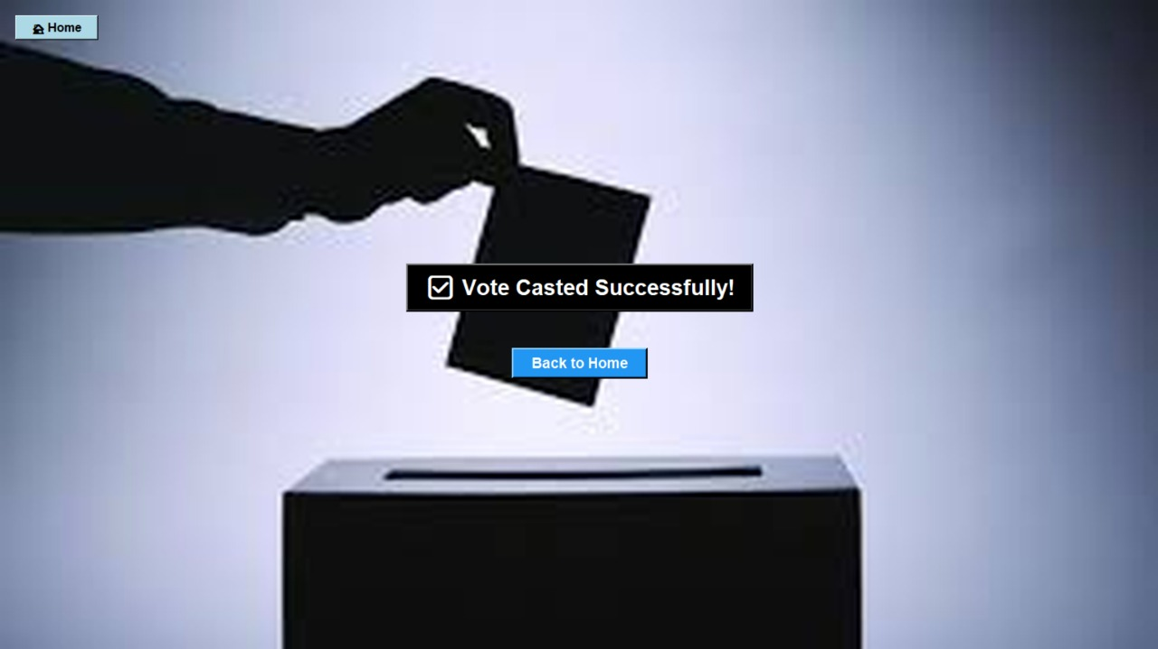
Output
OUTPUT:
The Vote Casted Page confirms successful submission of the voter’s choice and ensures one vote per user.

Slide 28
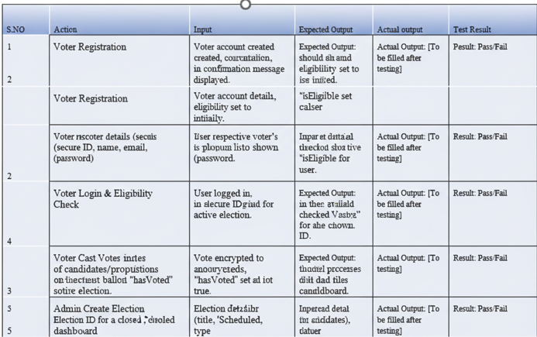
Test Cases
Test Cases

Slide 29
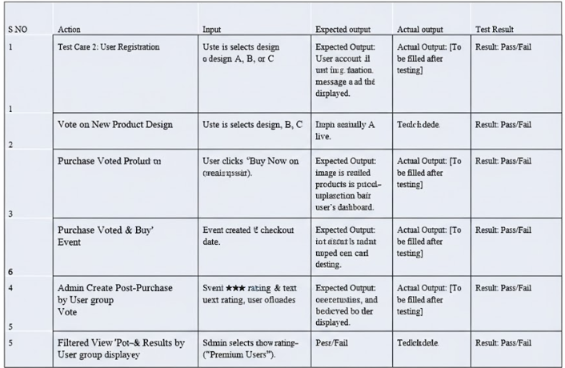
Test Cases
Test Cases For E-Commerce Voting System

Slide 30
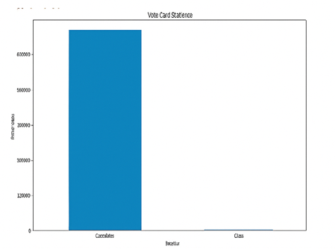
Results
Online Voting
Accuracy: 95%
Security: 90%
Efficiency: 93%
Inferences: Secure ,Reliable ,Fast Elections.

Slide 31
Conclusion
The Online Voting System provides a secure, efficient, and user-friendly platform for conducting elections digitally.
It eliminates manual errors, reduces time consumption and ensure transparency in the voting process
Features like user authentication, encrypted vote storage and real-time result computation make the system reliable and tamper-proof
This project demonstrates how technology can modernize the democratic process by making voting accessible, accurate and convenient
In future, the system can be enhanced with biometric verification or blockchain integration for even greater security trustworthiness

Slide 32
Future Work
Implement blockchain technology to make the voting process fully transparent and immutable.
Use fingerprint or facial recognition to enhance voter identity verification.
Develop a secure mobile app version for easier and more accessible voting.
Integrate AI models to detect unusual voting patterns or potential fraud automatically.
Host the system on secure cloud platforms for scalability and high availability.
Analyze voter participation and trends to improve future election processes.

Slide 33
References
https://eci.gov.in
Book Reference:
Schneier, B. (2015). Applied Cryptography: Protocols, Algorithms, and Source Code in C. John Wiley & Sons.
Stallings, W. (2023). Cryptography and Network Security: Principles and Practice. Pearson Education.
https://github.com/Kamaleshwa/online-voiting-system
https://www.loom.com/share/44a27caf0e954318b2d681df984eda13

Slide 34

Questions

Slide 35


